Slide 1

Chronical Kidney Dialysis
Submitted To:
Muhammad Shahid

Slide 2
Group Member (Group 12)
Dhrumil Shah - 0770271
Kushal Modi: - 0769555
Darshan Siddhpura - 0774684
Priyank Patel: - 0776470

Slide 3
Overview
Why Kidney Dialysis
Problem Statement
Dataset
Tools & Techniques
Pre-Processing
Analysis Charts
Why Machine Learning
Comparison of Models
Right Model - hyper parameters
Real-World Use
Reference
Questions

Slide 4
Why Kidney Dialysis ?
Chronic kidney disease (CKD) is the 16th leading cause of years of life lost worldwide.
Goal: Our kidneys are responsible for filtering blood and removing waste in the form of urine. Chronic kidney disease, commonly known as chronic kidney failure, is a progressive loss of kidney function. Dangerous quantities of fluid, electrolytes, and wastes can build up in the body at advanced stages. Patients must then undergo dialysis or consider a transplant if this occurs. Our goal in this experiment is to investigate if we can use 24 variables to predict whether a patient will develop chronic kidney disease or not. We may be able to recognize and help patients at risk of kidney failure if we can identify characteristics that have a strong influence on kidney failure.

Slide 5
Problem Statement
This project aims to develop a chronic kidney disease prediction model to predict whether the given patient is positive or negative for the disease based on training from the given dataset by using Machine Learning Models.

Slide 6
Dataset
Finalized data from UCI
Can be collected from the hospital nearly 2 months of period
Volume of Data (400 * 25)
Multivariate Characteristics
Numerical
Nominal

Slide 7
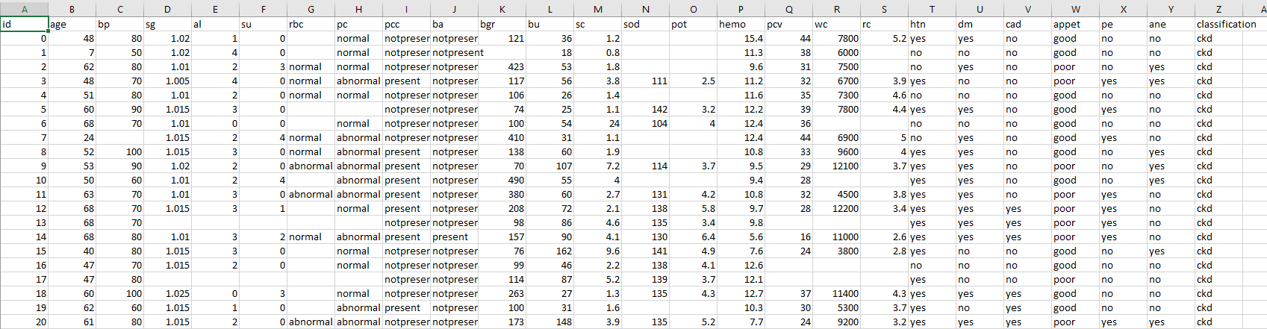
Glimpse of Data

Slide 8
Dataset Information
age - age
bp - blood pressure
sg - specific gravity
al - albumin
su - sugar
rbc - red blood cells
pc - pus cell
pcc - pus cell clumps
ba - bacteria
bgr - blood glucose random
bu - blood urea
sc - serum creatinine
sod - sodium
pot - potassium
hemo - hemoglobin
pcv - packed cell volume
wc - white blood cell count
rc - red blood cell count
htn - hypertension
dm - diabetes mellitus
cad - coronary artery disease
appet - appetite
pe - pedal edema
ane - anemia
class - class

Slide 9
Tools & Techniques
Excel
Jupiter Notebook
Sublime Text
Python
HTML
CSS

Slide 10




Pre-Processing
REMOVE NULL VALUES
DROP THE UNNECESSARY COLUMNS
CHECK THE SKEWNESS
CORRELATION BETWEEN FEATURES

Slide 11
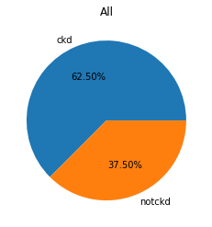
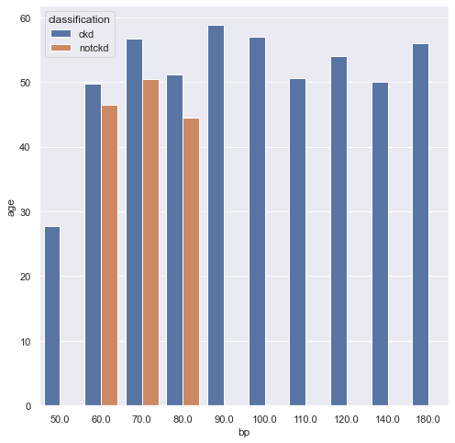
Analysis Charts
Distribution of Chronical and Non-Chronical Kidney Disease
Chronic Kidney Disease effect by Age and Blood Pressure

Slide 12
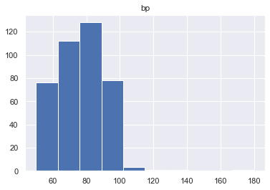
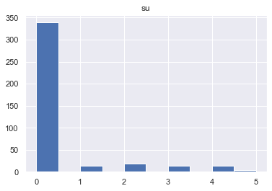
Analysis Charts
Distribution of Blood Pressure
Distribution of Sugar

Slide 13
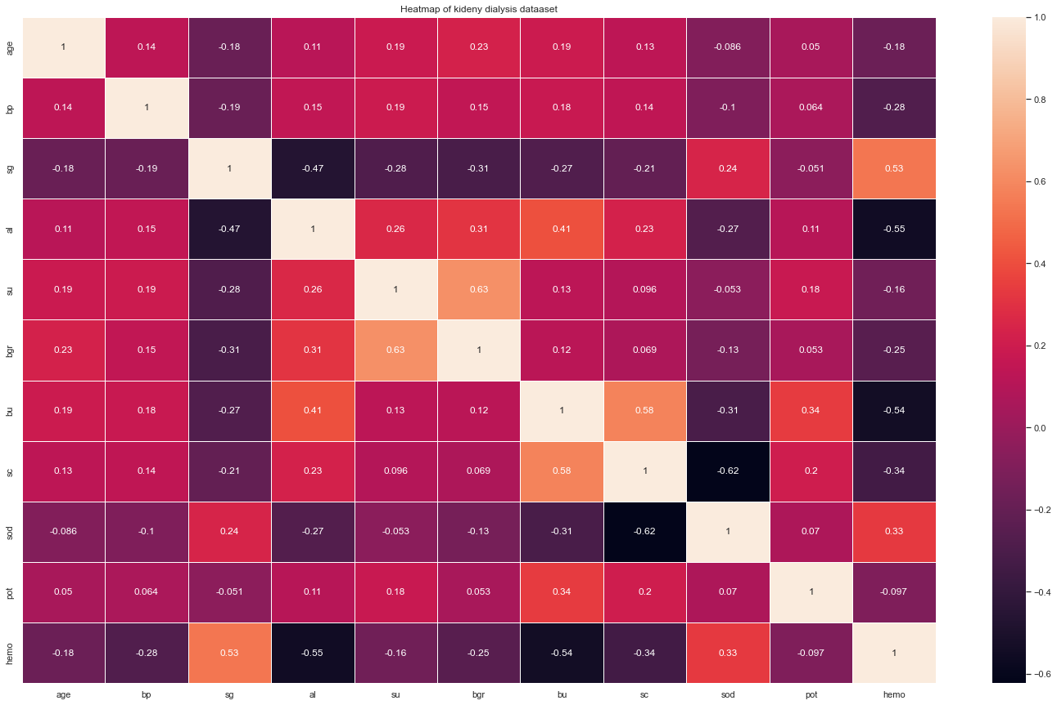
Heatmap of Kidney Dialysis

Slide 14
Why Machine Learning
Machine learning is a science technology that has been widely applied in the medical profession to boost medical research.
Early detection, disease diagnosis, and management are the most common applications.
Kidney disease remains a global health issue due to the large number of patients. Machine learning gave the opportunity to explore in healthcare.

Slide 15
Comparison of Models
Split Ratio 70:30
Machine Learning Model | Accuracy Score
 | Train Dataset | Test Dataset
Random Forest Model | 100 | 0.989286
Decision Tree Classifier | 100 | 0.917857
KNN | 83.33 | 0.710714
SVM | 100 | 0.621429
MLP | 63.33 | 0.621429

Slide 16
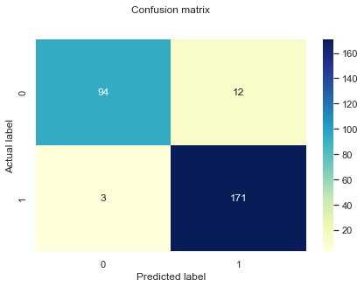
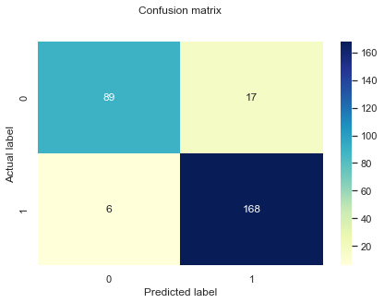
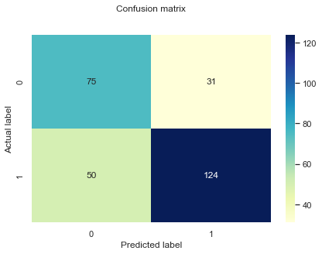
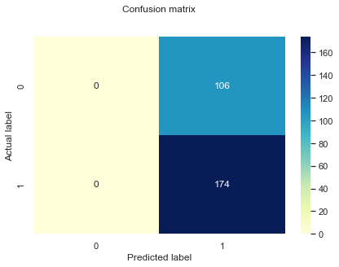
Right Model – Hyper parameters
Random Forest Model
Decision Tree Classifier
KNN
SVM
MLP

Slide 17
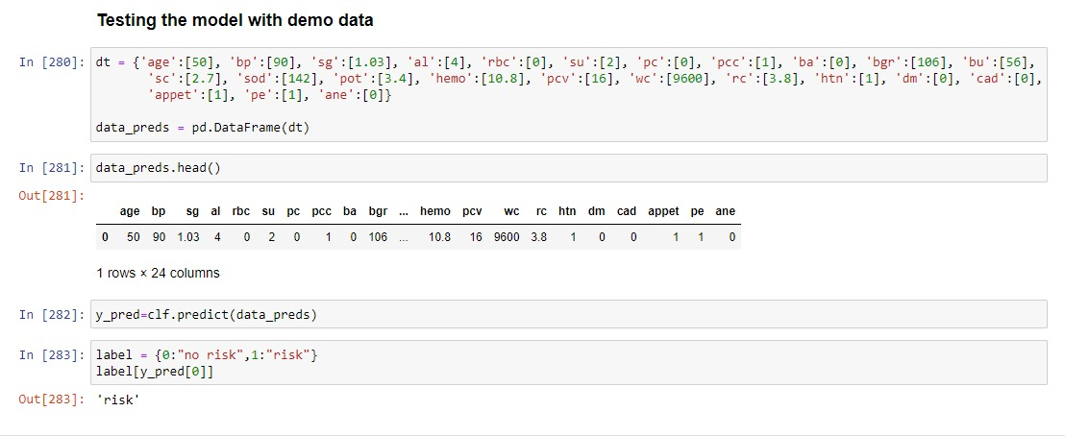

Slide 18
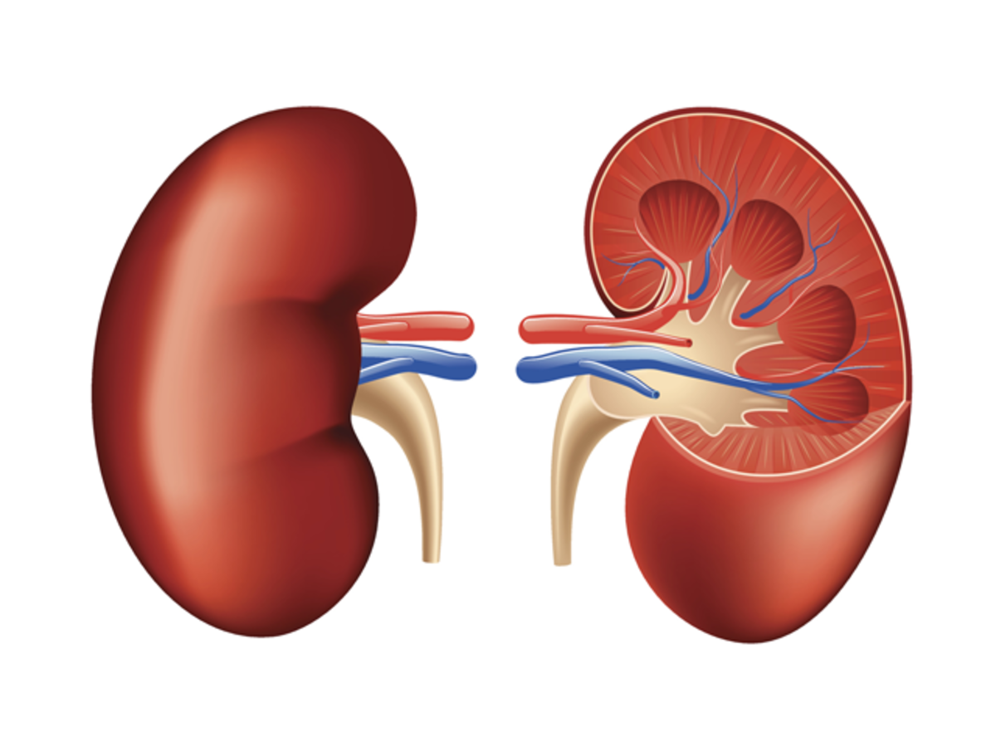
Front-End
Prediction Form

Slide 19
References
https://archive.ics.uci.edu/ml/datasets/chronic_kidney_disease
https://dom-pubs.onlinelibrary.wiley.com/doi/full/10.1111/dom.14178
https://www.sciencedirect.com/science/article/pii/S2468024919313877
https://journals.sagepub.com/doi/full/10.1177/2054358118776326
https://journals.plos.org/plosone/article?id=10.1371/journal.pone.0250467#sec005

Slide 20


